Slide 1
Chapter 8
Modern Decision Trees with SAS Enterprise Miner and Current Machine Learning Tools
Teh Ying Wah tehyw@um.edu.my University of Malaya

Slide 2
course outline
Introduction
History of decision trees
Getting Started with SAS Enterprise Miner
Introduction to Decision Tree Node in SAS Enterprise Miner
Building Your First Decision Tree
Advanced Configuration and Tuning
Ensemble Methods: Boosting and Bagging

Slide 3
Introduction - Overview of Decision Trees
1. What is a Decision Tree?
A Decision Tree is a flowchart-like tree structure where an internal node represents a feature(or attribute), the branch represents a decision rule, and each leaf node represents an outcome.
2. Key Components:
Root Node: Represents the entire population or sample and gets divided into two or more homogeneous sets.
Decision Node: When a sub-node splits into further sub-nodes, then it's called the decision node.
Leaf/ Terminal Node: Nodes that do not split are called Leaf or Terminal nodes.
Splitting: The process of dividing a node into two or more sub-nodes.
Branch / Sub-Tree: A subsection of the entire tree is called a branch or sub-tree.
Parent and Child Node: A node, which is divided into sub-nodes is called a parent node, whereas sub-nodes are the child of the parent node.

Slide 4
Introduction - Overview of Decision Trees
3. How Does It Work?
Decision Trees split the data into subsets. This process is repeated recursively, resulting in a tree-like model of decisions.
At each internal node of the tree, a decision is made about which way to go based on the value of an input feature, leading to a final prediction at the leaf nodes.
4. Types of Decision Trees:
Categorical Variable Decision Tree: Decision Tree which has a categorical target variable [1]
Continuous Variable Decision Tree: Decision Tree which has a continuous target variable [2]

Slide 5
Introduction - Overview of Decision Trees
5. Algorithms Used:
ID3 (Iterative Dichotomiser 3)
C4.5 (Successor of ID3)
CART (Classification and Regression Trees)
CHAID (Chi-squared Automatic Interaction Detector).
6. Advantages:
Easy to understand and interpret.
Requires little data preprocessing.
Can handle both numerical and categorical data.
Can handle multi-output problems
7. Disadvantages:
Prone to overfitting, especially with large trees.
Can be unstable due to small variations in data.
Biased to attributes with more levels.
Not always the best in terms of prediction accuracy.

Slide 6
Introduction - Overview of Decision Trees
8. Applications:
Used in many domains such as healthcare, finance, manufacturing for classification and regression tasks.
Commonly used for understanding and visualizing the decision-making process.
9. Decision Tree vs. Random Forest:
A single Decision Tree is often prone to overfitting, whereas Random Forest, an ensemble method, combines multiple decision trees to produce a more generalized model.
10. Pruning:
A technique used to reduce the size of the tree and mitigate overfitting. It involves removing sections of the tree that provide little power in predicting target values.
This overview should provide a good starting point for understanding Decision Trees. They serve as a fundamental building block for many other machine learning algorithms, especially ensemble methods like Random Forest and Gradient Boosted Trees.

Slide 7
identify overfitting in a decision tree
High Training Accuracy but Low Test Accuracy: If the model performs exceptionally well on training data but poorly on test or new data, it's likely overfitting.
Complex Tree Structure: A tree that has grown too deep with many branches might be capturing noise and specific patterns in the training data rather than general trends.
Minimal Improvement with Additional Data: If adding more data doesn't improve model performance, it may be overfitted to the original dataset.
Regularization techniques like pruning the tree or setting a maximum depth can help prevent overfitting.

Slide 8
Scenario Description
Overfitted Data: The training data might include very specific, noisy, or irrelevant features that the model learns as significant. This could lead to a model performing exceptionally well on the training set but poorly on the testing set, which does not contain these specific patterns.
Unbalanced Classes: If the training data has unbalanced classes (more instances of one class than another), the model might become biased towards predicting the majority class, performing well on the training set but poorly on a more balanced testing set.
Limited Generalization: The data contains complex, high-dimensional features which the model learns too specifically, leading to poor performance on unseen data.

Slide 9

Underfitting in decision trees
characterized by high bias, occurs when the model is too simple to capture the underlying patterns in the data. Several factors can contribute to underfitting in decision trees:
Insufficient Depth: If a decision tree is too shallow (i.e., it has very few layers of decisions), it might not capture the complexities and subtleties in the data. A deeper tree can represent more decision paths and potentially capture more varied patterns in the data.
Excessive Pruning: While pruning is used to reduce overfitting by trimming off branches of the tree that don't provide much predictive power, overly aggressive pruning can lead to underfitting. If you remove too many branches, the tree might become too generalized to make accurate predictions.

Slide 10

Underfitting in decision trees
Limited Features Used: If the decision tree doesn't consider all relevant features, or if important features are missing from the dataset, the tree cannot make well-informed splits. This lack of information can lead to overly simplistic models that don't perform well.
Large Bins for Continuous Variables: When dealing with continuous variables, the way you bin these variables can impact model performance. Too large bins might cause the model to miss out on important nuances in the data.
Poor Quality Data: If the training data is noisy, lacks diversity, or has a lot of missing values, the decision tree may not be able to learn effectively from this data, leading to a model that doesn't generalize well to new data.

Slide 11
Underfitting in decision trees
Ignoring Interactions Between Features: Standard decision trees may not effectively capture interactions between features unless the tree is sufficiently deep. If the data has complex interactions between variables, and the tree is not deep enough to capture these, it can lead to underfitting.
Inadequate Training: If the model is not trained for enough time or with enough data, it may not fully "learn" the patterns present in the data. This is particularly relevant when using tree-based ensemble methods like Random Forests or Gradient Boosting, where inadequate training can result in weak individual trees.
To address underfitting, one can experiment with increasing the depth of the tree, considering more features, using more granular bins for continuous variables, improving data quality, or using more sophisticated models that can capture complex patterns and interactions in the data. Additionally, ensemble methods like boosting can help improve the performance of weak learners like underfitted decision trees.

Slide 12

History of decision trees
1. 1960s: Emergence of Decision Trees
The concept of decision trees began to take shape in the 1960s.
Morgan and Sonquist introduced the Automatic Interaction Detector (AID) as one of the first computer-based decision tree algorithms. It was used primarily for socio-economic data.
2. 1970s: Iterative Dichotomiser (ID3)
Ross Quinlan, a researcher from Australia, played a significant role in the advancement of decision tree algorithms.
In the 1970s, he introduced the ID3 (Iterative Dichotomiser 3) algorithm, which utilized entropy as a metric for attribute selection.
3. 1980s: Evolution of Algorithms
Quinlan further refined his decision tree algorithm and introduced C4.5 in the 1980s, which was an improvement over ID3.
C4.5 introduced the concept of information gain ratio and had better handling for missing data and continuous attributes.
Breiman et al. introduced the CART (Classification and Regression Trees) algorithm, which could handle both classification and regression tasks. CART introduced the Gini impurity as a metric and utilized binary splits, different from the multi-way splits in ID3 and C4.5.

Slide 13
History of decision trees
4. 1990s: Commercialization and Popularity
Decision tree algorithms became a fundamental tool in the emerging field of data mining.
Many commercial data mining software suites, including SAS Enterprise Miner and IBM SPSS, integrated decision tree capabilities.
The popularity of decision trees grew not only because of their predictive power but also due to their interpretability, making them preferable in industries like finance, healthcare, and marketing.
5. 2000s: Ensemble Methods
The 2000s saw the rise of ensemble methods, which combined multiple decision trees to produce more accurate and robust models.
Algorithms like Random Forest (by Breiman) and boosting techniques became popular, wherein multiple trees vote or contribute to a final prediction.
XGBoost, a gradient boosting framework, became a dominant algorithm in machine learning competitions due to its efficiency and accuracy.

Slide 14
History of decision trees
6. Modern Era: Integration with Deep Learning
While traditional decision tree algorithms remain popular, there's increasing interest in integrating decision trees with deep learning techniques.
Neural decision trees and differentiable decision trees are emerging concepts that combine the interpretability of decision trees with the power of neural networks.
Throughout their history, decision trees have been appreciated for their visual interpretability, ease of understanding, and applicability across various domains. They've laid the foundation for many advanced machine learning techniques and continue to be a topic of research and application in the modern data-driven era.

Slide 15

Ensemble Methods: Boosting and Bagging
1. Basic Concept:
The core idea behind ensemble methods is that a group of "weak learners" can come together to form a "strong learner".
Each learner, typically, is a small model that makes its predictions. The ensemble then consolidates these predictions to produce a final output.
2. Bagging (Bootstrap Aggregating):
2.1. What is Bagging?
Bagging stands for Bootstrap Aggregating.
It involves creating multiple subsets (samples) of the original dataset using bootstrap sampling (sampling with replacement).
A model is trained on each of these samples.
For predictions, bagging takes an average (for regression) or a majority vote (for classification) from all the models

Slide 16

Regression (Continuous Output)
In regression problems, where the output is continuous, the predictions of the individual models are usually averaged to produce the final prediction.
For instance, if you have a regression problem to predict house prices, and you train multiple models on different subsets of your data, each model will predict a price for a given house.
The final prediction for that house would be the average of all these predictions. This averaging helps to reduce variance and can lead to more accurate and stable predictions, especially in cases where individual models might overfit the data.

Slide 17

Classification (Categorical Output)
In classification problems, where the output is categorical (like 'spam' or 'not spam'), the predictions of the individual models are typically combined through a majority vote.
Each model votes for a class, and the class with the majority of votes becomes the final prediction.
This approach is effective because it allows the ensemble to achieve better performance than any single model, especially if the models are diverse and their errors are uncorrelated.
The majority vote approach can help in reducing both bias and variance in the predictions.

Slide 18
Hybrid Decision Tree
which combine categorical and continuous types, often used in XGBoost and CatBoost.
Gradient Boosting and XGBoost.
Gradient Boosting: Builds decision trees sequentially, where each new tree aims to correct the errors made by the previous ones. This reduces both bias and variance, making it highly effective for predictive tasks.
XGBoost (Extreme Gradient Boosting): An advanced version of gradient boosting designed for speed and performance:

Slide 19
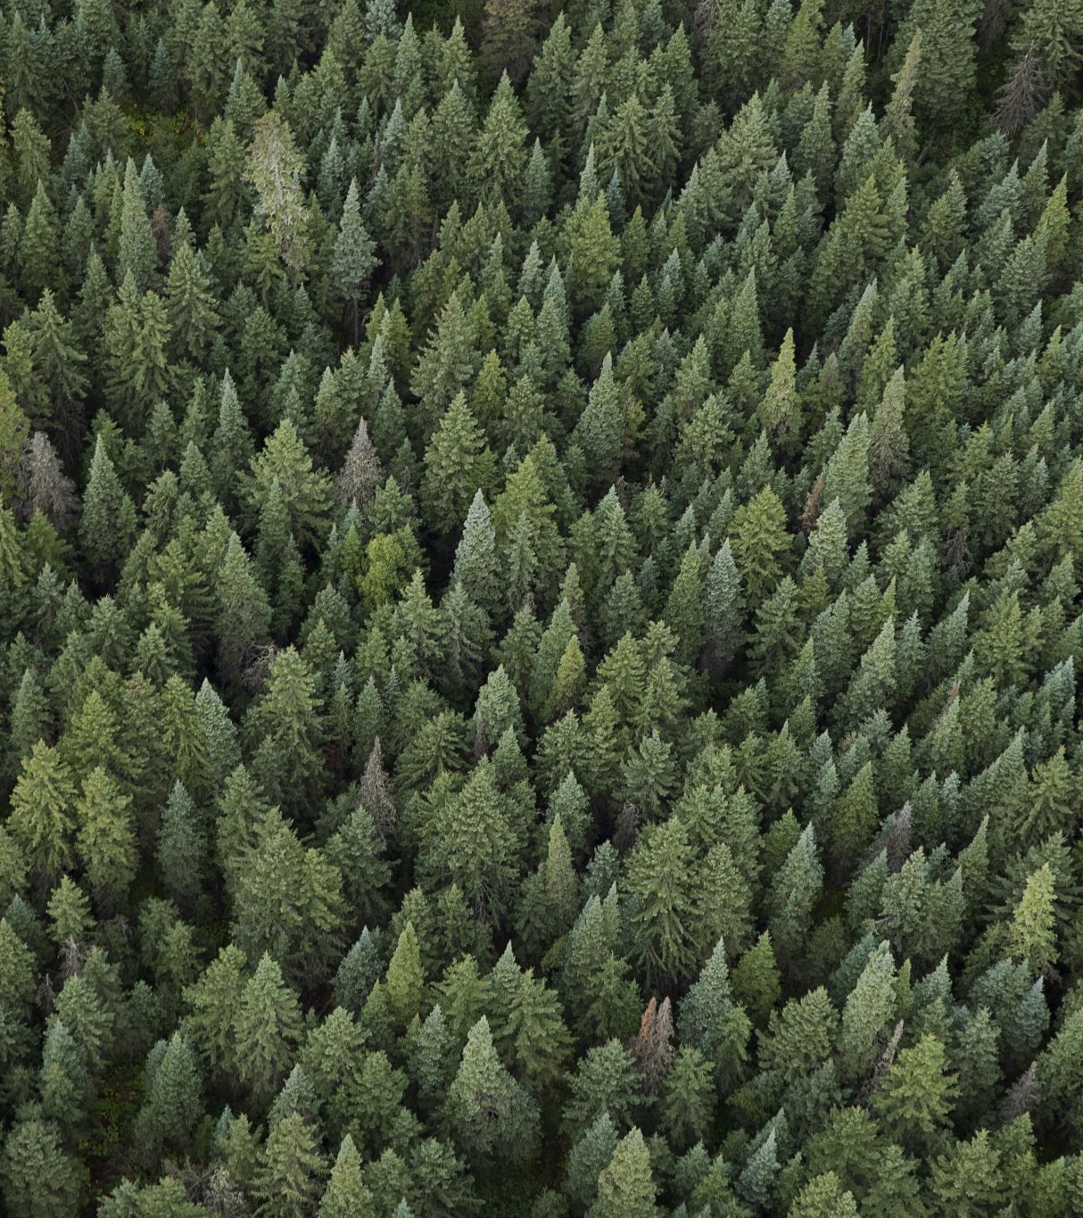
Ensemble Methods: Boosting and Bagging
2.2. Benefits:
Reduces variance by averaging out individual predictions, leading to a more stable model.
Can parallelize training since each model is built independently.
2.3. Popular Algorithms:
Random Forest: It's a bagging technique based on decision trees. It introduces additional randomness by selecting a subset of features for each split.

Slide 20
Ensemble Methods: Boosting and Bagging
3. Boosting:
3.1. What is Boosting?
Boosting involves training models sequentially.
Each subsequent model tries to correct the errors of its predecessor.
The models, when combined, give a weighted sum (or vote) based on their accuracy.
3.2. Benefits:
Boosting can convert weak learners to strong learners by focusing on instances that are hard to predict.
Often results in higher accuracy compared to bagging, especially if the models are underfitting.
3.3. Popular Algorithms:
AdaBoost (Adaptive Boosting): The first practical boosting algorithm. It adjusts the weights of misclassified instances at each iteration.
Gradient Boosting: Builds trees one at a time, where each new tree helps to correct errors made by previously trained trees. It uses gradient descent to minimize the loss.
XGBoost: An optimized and regularized version of Gradient Boosting.

Slide 21
Ensemble Methods: Boosting and Bagging
4. Differences between Bagging and Boosting:
Sampling: Bagging uses bootstrap sampling to obtain dataset subsets. Boosting re-weights or re-samples the dataset based on the prediction errors.
Model Building: In Bagging, models are built independently, while in Boosting, models are built sequentially.
Final Prediction: Bagging takes a simple average or majority vote, while Boosting assigns weights to each model's prediction based on its accuracy.
Error Reduction: Bagging focuses on reducing variance and typically works best with high variance, low bias models. Boosting focuses on reducing both bias and variance.

Slide 22
Ensemble Methods: Boosting and Bagging
5. When to use which method?
Bagging:
When the model has high variance (e.g., a deep decision tree).
When the dataset is large enough to ensure diverse subsets.
Boosting:
When the model has high bias (e.g., a shallow decision tree).
When you require higher predictive accuracy and are okay with slightly increased complexity.
Both Bagging and Boosting offer ways to improve the performance of single predictive modelling techniques. However, they come with their own sets of advantages and considerations, and the choice between them often depends on the specific problem and dataset at hand.

Slide 23
Getting Started with SAS Enterprise Miner
1. Creating a New Project:
Go to File -> New -> Project.
Provide a name for your project and select a location to save it.
Set up the data source. SAS Enterprise Miner integrates with various data sources, including databases, flat files, and SAS datasets.
2. The Data Source Wizard:
Use the wizard to connect to your data source.
Specify the type of data (interval, nominal, ordinal) for each variable.
Identify the target variable, if any (for supervised learning tasks).
3. Exploring Data:
Once the data is loaded, use the various visualization and statistics tools available in Enterprise Miner to understand and explore your dataset.
This step is crucial for understanding the quality and characteristics of your data.

Slide 24
Getting Started with SAS Enterprise Miner
4. The Diagram Workspace:
This is where you'll "draw" your data mining or predictive modeling process.
You can drag and drop various nodes (like data processing, algorithms, model evaluation) onto the workspace and connect them to design your workflow.
5. Building a Simple Model:
Drag a data source node onto the diagram workspace.
Add a modelling node, like Decision Tree or Regression, and connect it to your data source node.
Configure the settings of the modelling node as required.
Run the process and review the results.
6. Evaluating Models:
Use nodes like "Model Comparison" to evaluate multiple models simultaneously.
Review various metrics like RMSE (Root Mean Square Error), MAE (Mean Absolute Error), etc., to determine the best model.

Slide 25
Advanced Configuration and Tuning in SAS Enterprise Miner
1. Splitting Criteria:
Entropy: Measures the randomness or unpredictability in the dataset.
Gini: Measures the impurity of the dataset.
Variance Reduction: Used for regression trees. It selects the split that results in the highest reduction in variance.
Chi-Square: Measures the statistical significance of the difference between the observed and expected frequencies in the categories.
2. Handling Overfitting:
Maximum Depth: Limit the depth of the tree. A deeper tree might fit the training data very well but may not generalize well to new data.
Minimum Split Size: Set the minimum number of observations required to attempt a split at a node.
Minimum Leaf Size: Define the smallest size of end-nodes or leaves.
Pruning: Use reduced error pruning or cost complexity pruning to remove branches that have weak predictive power.

Slide 26
Modern Tools and Technologies
tools like H2O.ai, AutoML, cloud-based ML services (AWS Sagemaker, Google AI Platform)
General Workflow for Implementing Decision Trees Across Platforms:
Data Preparation: Import and preprocess data, often using platform-specific tools like data wrangling in Azure Data Factory or AWS Glue.
Tree Configuration: Configure tree parameters such as:
Splitting Criterion: Options like Gini, Entropy, or variance reduction for regression.
Depth and Pruning: Set maximum depth and specify pruning strategies to avoid overfitting.
Training and Evaluation: Train models on labeled datasets, often using cross-validation to ensure generalizability.
Deployment: Deploy the trained decision trees using REST APIs or integrate them into applications using platform-specific deployment tools (SageMaker Endpoints, Azure Kubernetes Service).
Monitoring and Retraining: Continuously monitor deployed models for accuracy drift and retrain as needed, which many platforms, such as Google AI and IBM Watson, support automatically.
Modern ML platforms make decision tree implementation efficient by combining intuitive tools, cloud scalability, and integration with advanced technologies like AutoML, making them accessible for both data scientists and non-experts alike.

Slide 27
Modern Real-World Applications
Traditional applications like finance and healthcare.
new applications such as:
Healthcare: Use in predicting patient outcomes using ensemble methods.
E-commerce: Personalized recommendations using decision trees combined with deep learning.
Real-Time Systems: Autonomous driving, where decision trees are integrated into decision frameworks.

Slide 28
References
[1] https://stackoverflow.com/questions/47586562/scikit-decision-tree-categorical-features
[2]https://www.youtube.com/watch?app=desktop&v=g9c66TUylZ4&t=81s&ab_channel=StatQuestwithJoshStarmer

